Slide 1
CrowSoft Technologies
Ruth Lennon P.O.
Charles Aylward
Mary Walsh McGinty
Joji Thokala
Matthew Mc Colgan
Bharathi Gadhiraju
Michael Mcfadden
Liam Whorriskey
Colin Kenny

Slide 2
Purpose Online Business Intelligence to analyze building suitability and running costs.
Customer facing on-line system to analyse Building data
Customer will enter building information
upload files or images
Analysis features
Review similar building within a given price range
Display costs associated to each building
Maintenance projects associated to any special features
Requirement
The analysis system should be clean and simple
simplified graphics
administrator has access to edit detailed information
Once a client enters details it should not be able to be changed by the client

Slide 3
Schedule / Goals
CrowSoft is currently in the Prototype Development stage
10 week goal to have Development Running with its own Pipeline
Environments are running on VMs hosted by LYIT Datacentre (Scalable)
No patents sought to date or known intellectual property issues
Due to project limitations Open Source software has been used as much as possible
User requirements have been drawn up and approved by the product owner
SLA draft is in place to be signed off by Project Owner
Adopted Agile methodology with 1 week sprints 10 hours per person

Slide 4





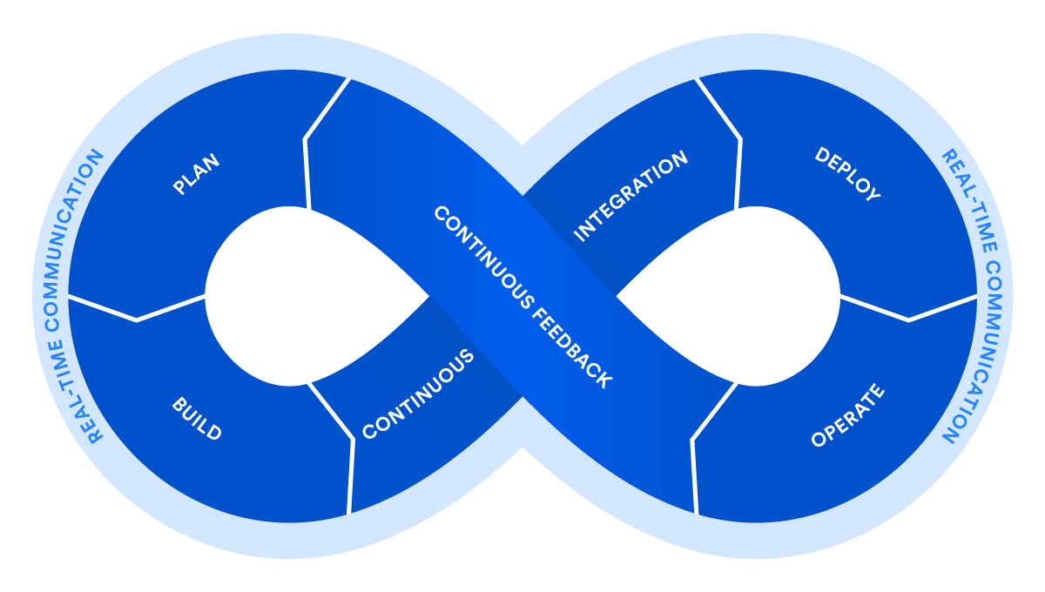










Technologies & DevOps Process
Requirements & Planning
Configuration Management
Continuous Integration & Deploy
Deployment
Environments
Collaboration
Operate & Monitor
Build
Automated Testing
Wrk
Performce Tests

Slide 5
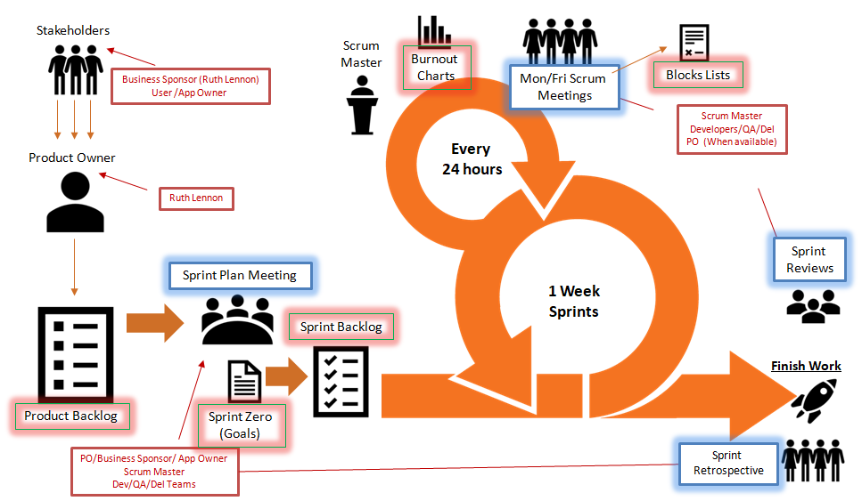

CrowSoft Agile Process

Slide 6
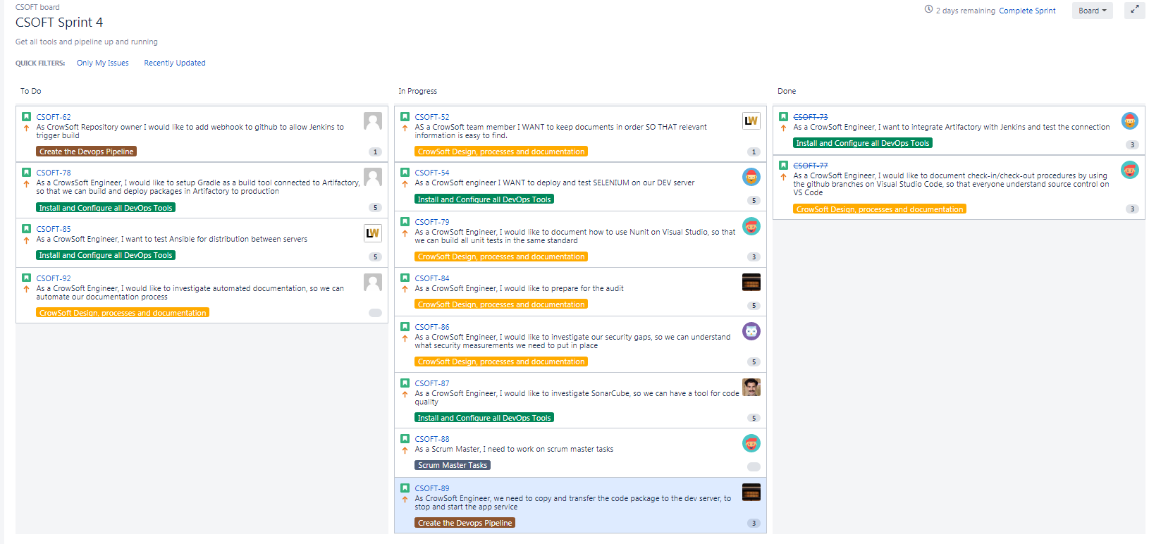
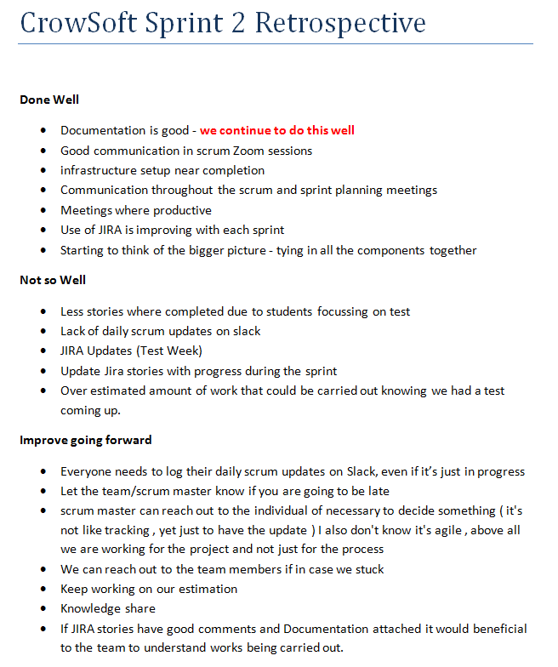
JIRA Sprint
Retrospective

Slide 7





Development Environment
Jenkins Server
Dev Server
Ubuntu 16.04
.NET Core
MySQL
Nunit
Monit
Open SSH
Wk Per. Tests
Testing
Jenkins
Java
Open SSH
Putty
Git
Ansible
Jfrog Artifactory
Selenium
Live
github.com
/rlennon
/CrowSoft

Slide 8
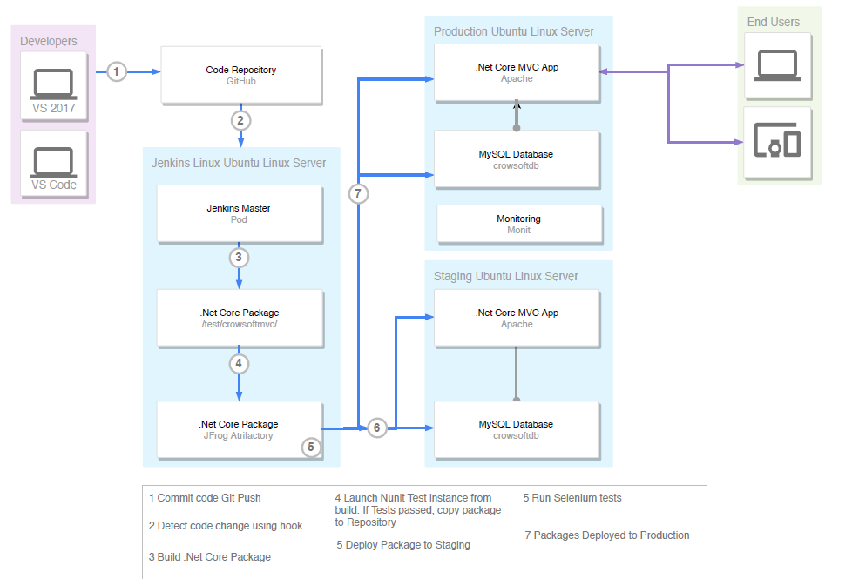
DevOps Pipeline

Slide 9
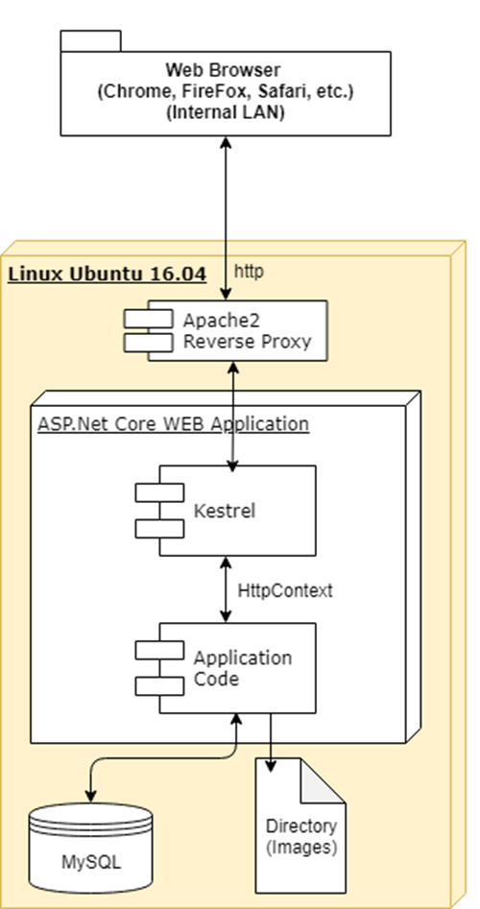
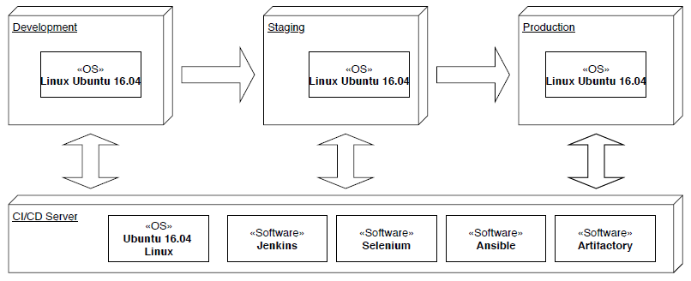
Software Stack
Infrastructure

Slide 10
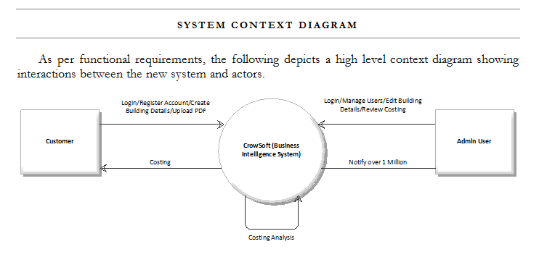
System Context

Slide 11
Code Repository
GitHub
https://github.com/rlennon/CrowSoft

Slide 12
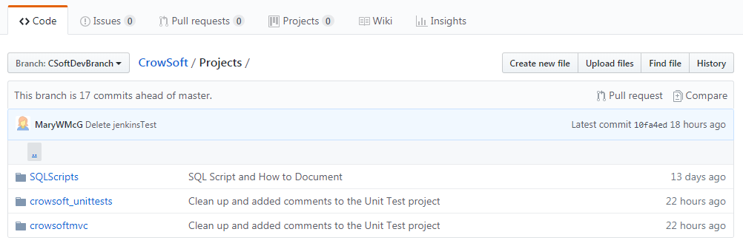
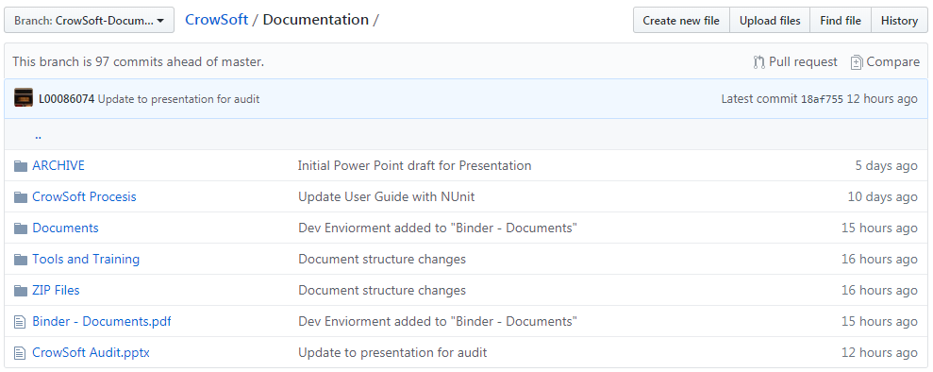
GitHub DeV Branch & Documentation Branch

Slide 13
Security / Risk
Security is still in the planning stage
Application groups permissions are in progress
Application monitoring Via Monit
Proposed Standards to be adopted
PCI
SOX
ISO27000
HIPAA
NIST

Slide 14
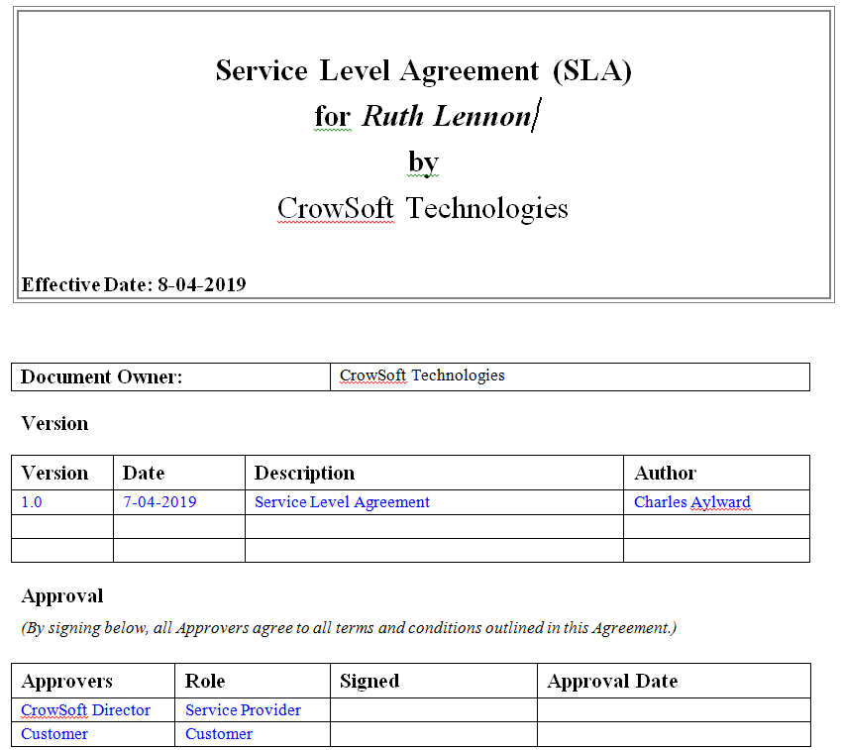
Service Level Agreement

Slide 15
Questions

